Slide 1
Robo-Rally
Created by the re-creators of beloved game Love-Letter ,now with a new team : Blinde-Bonbons

Slide 2


Agenda
Introduction
Game Windows
Start Screen
Game Guide
Server IP & Port
Choose Robots
Chat in the Game
Available Maps
Playing the Game
Conclusion

Slide 3

Introduction
The only intro the Blinde-Bonbons need:

Slide 4
Game Windows

Slide 5
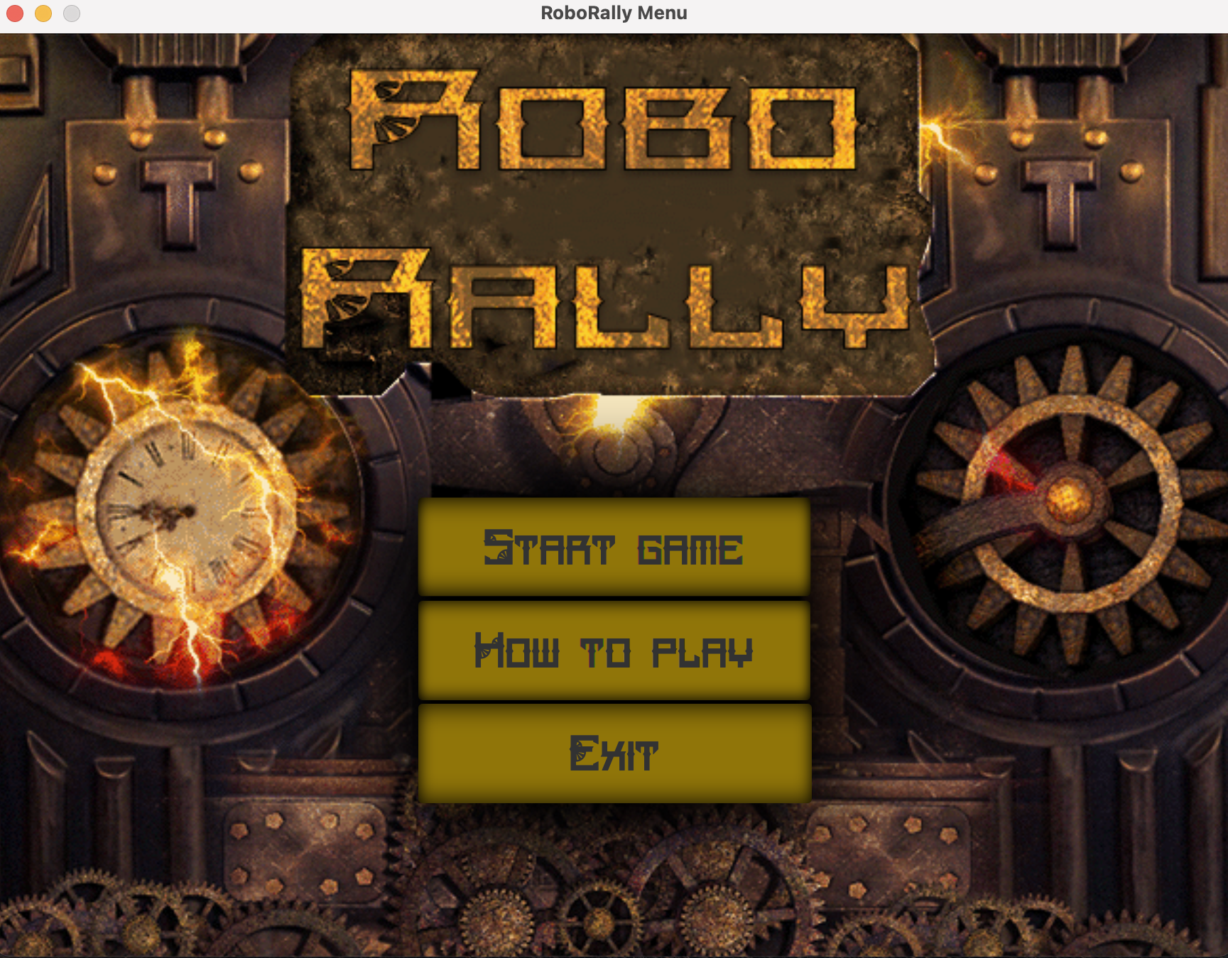
Start Screen
There are 3 buttons.
Start Game goes to the next Window
How to Play opens the Game Guide
Exit closes the window

Slide 6
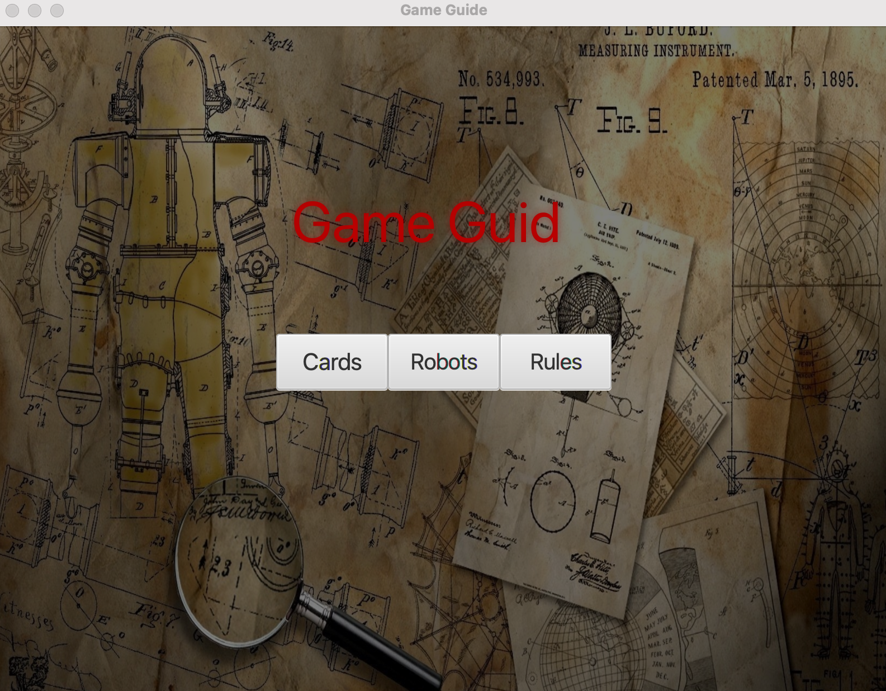
Game Guide
3 buttons
Cards Button opens the cards and their explanations
Robots button shows the Robots
Rules are to be broken especially if you are Steampunk, however they are important if you want to win

Slide 7
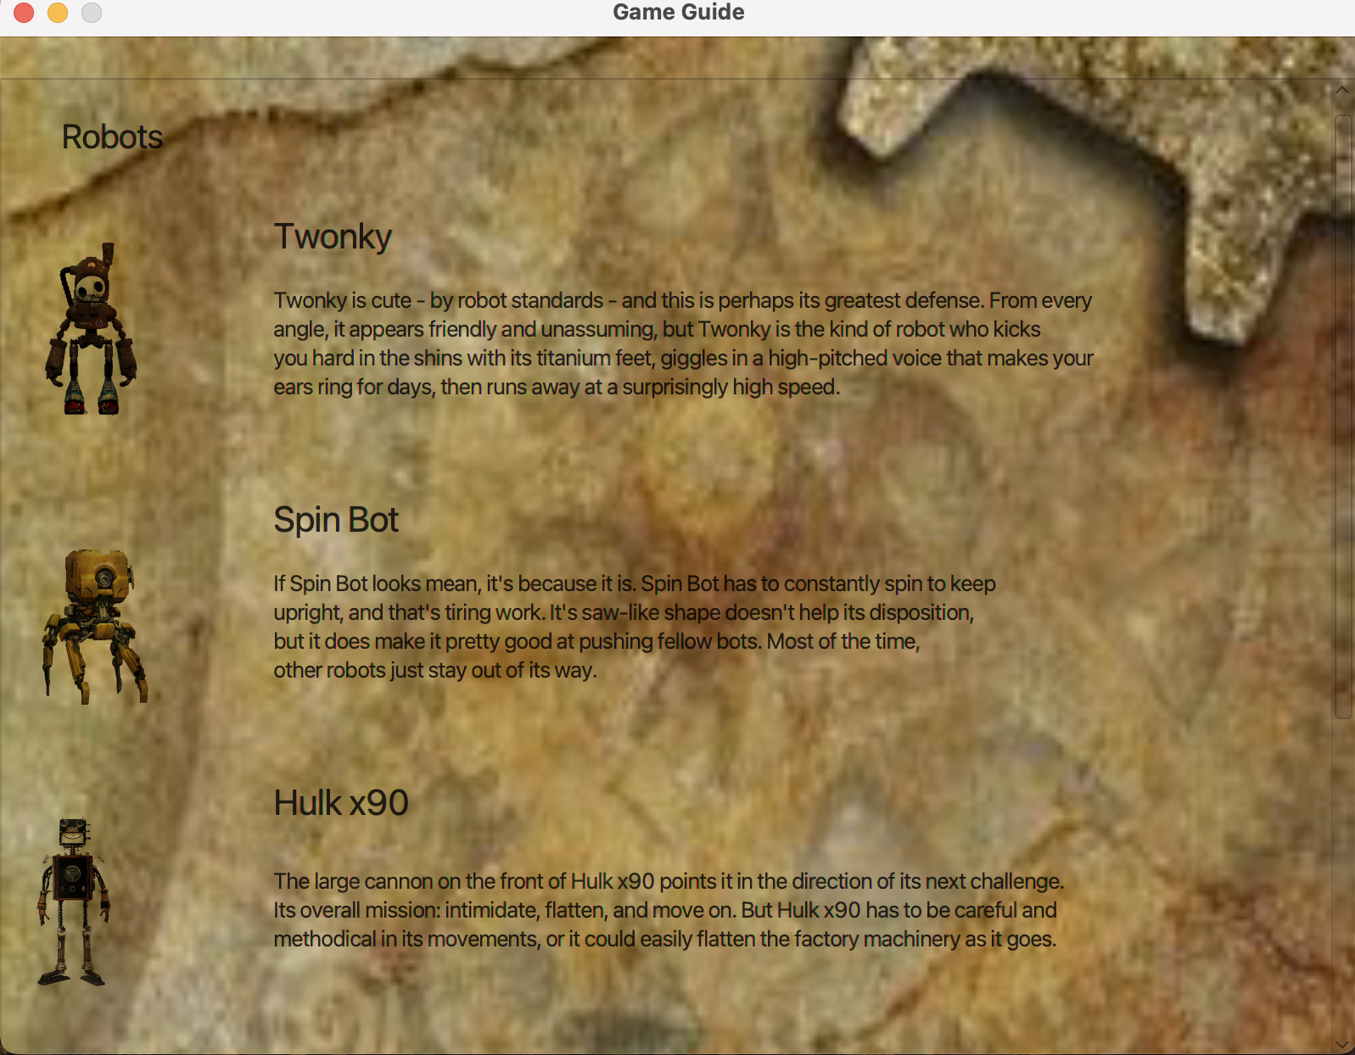
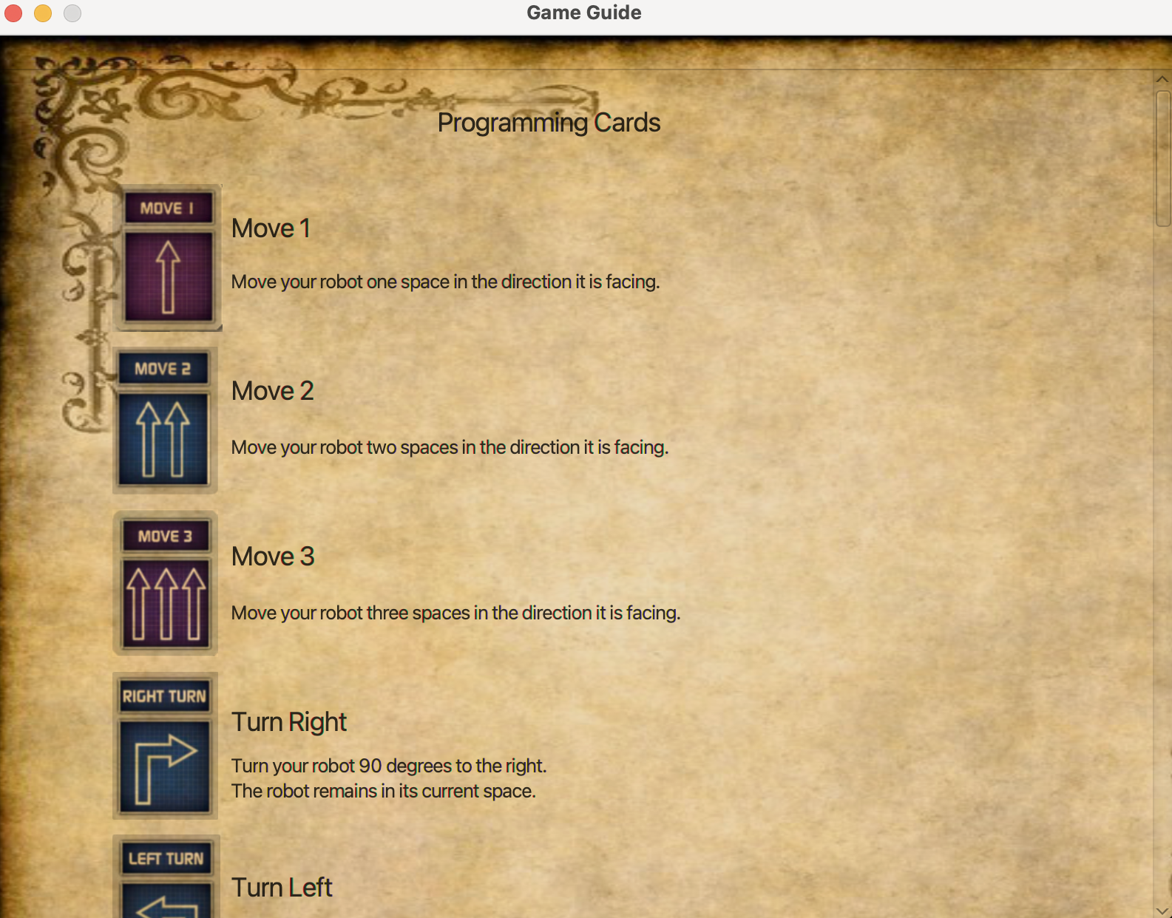
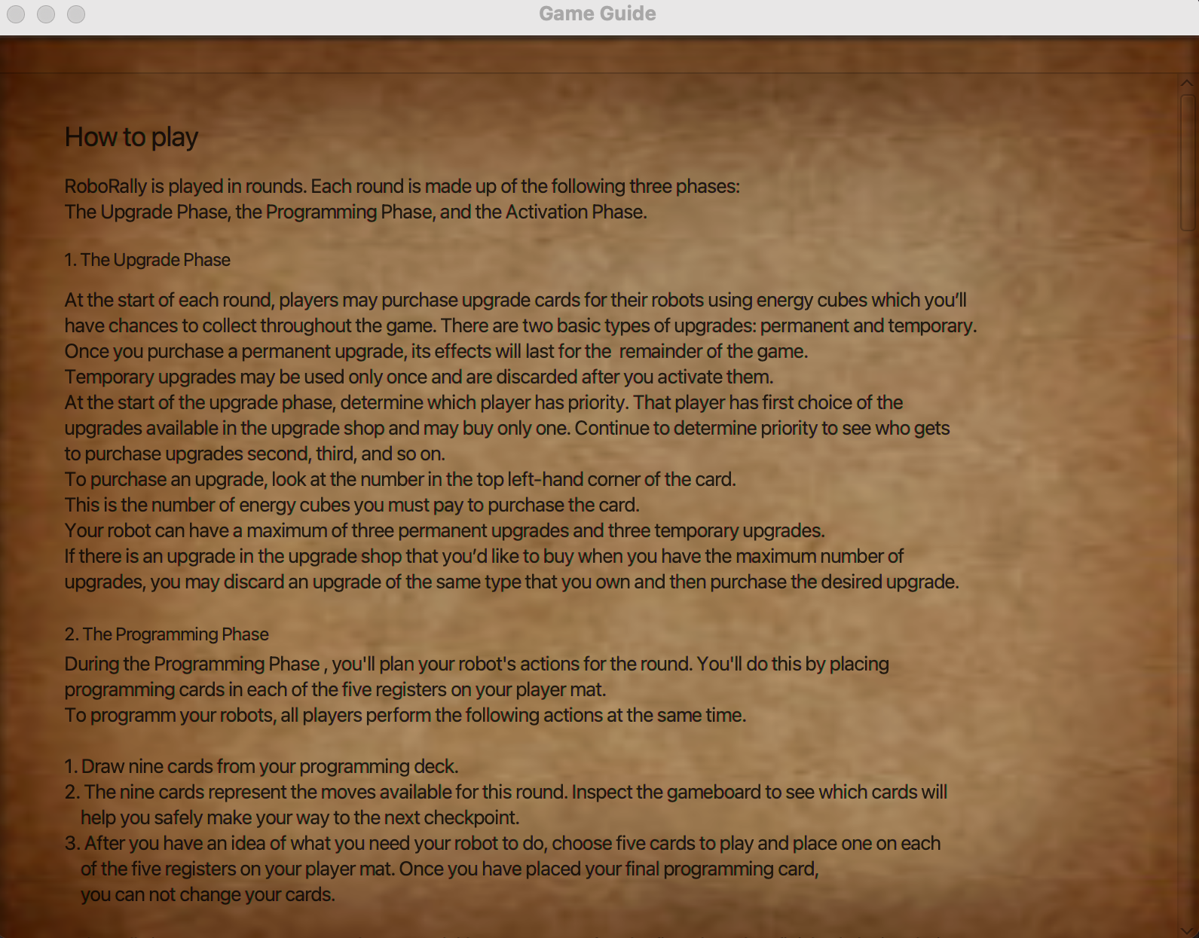

Slide 8
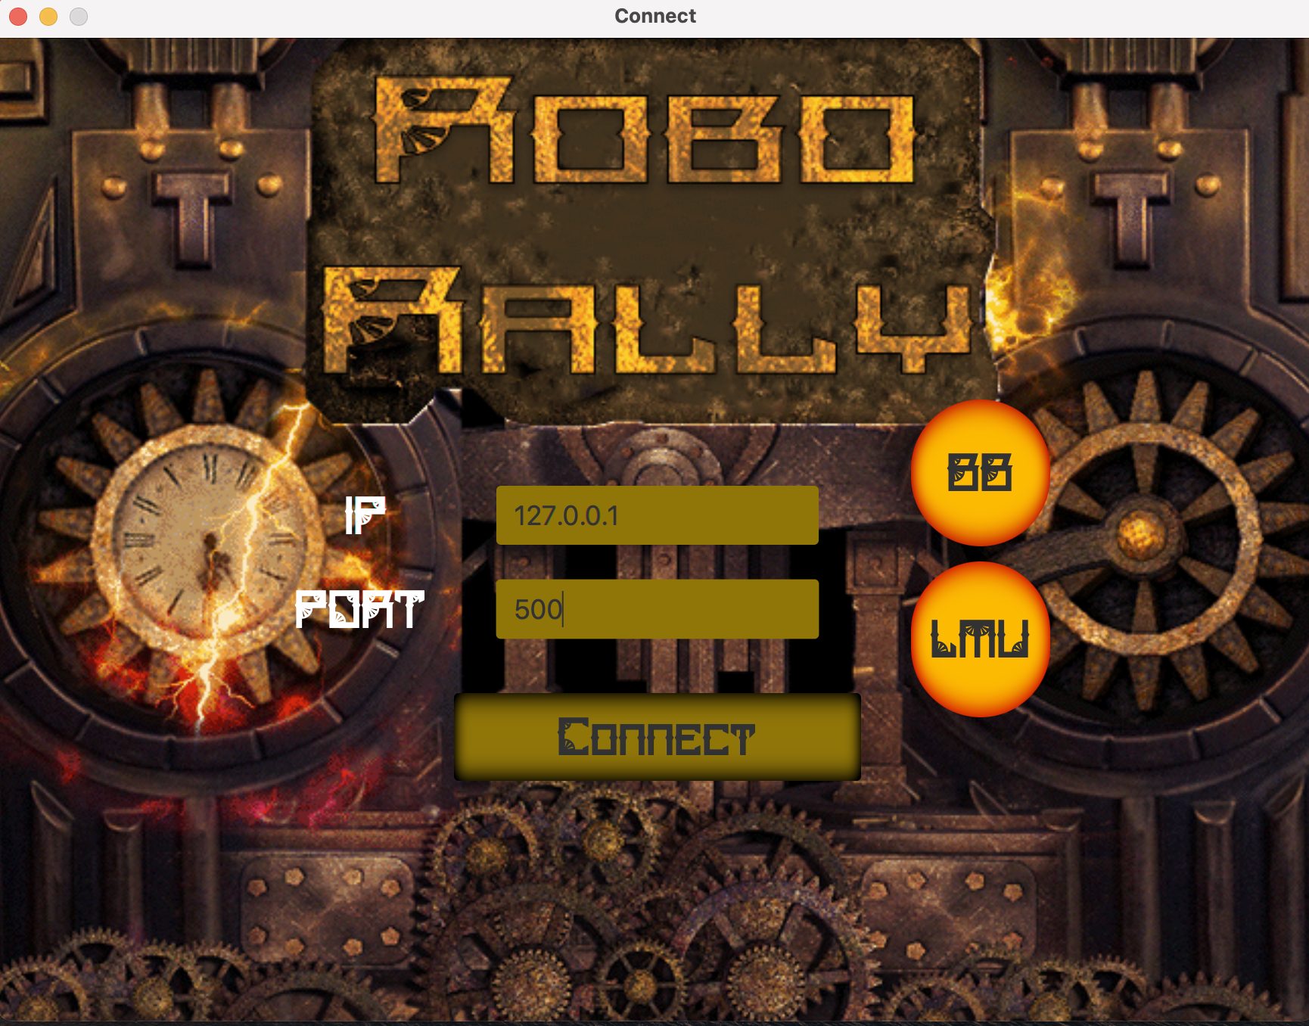
Server IP & Port
3 Buttons in total
BB button gives the BB server IP and Port
LMU Button gives the LMU server’s IP and Port
Connect Button connects the client to the server
Be careful, if your IP and Port is wrong, then you get a Warning

Slide 9
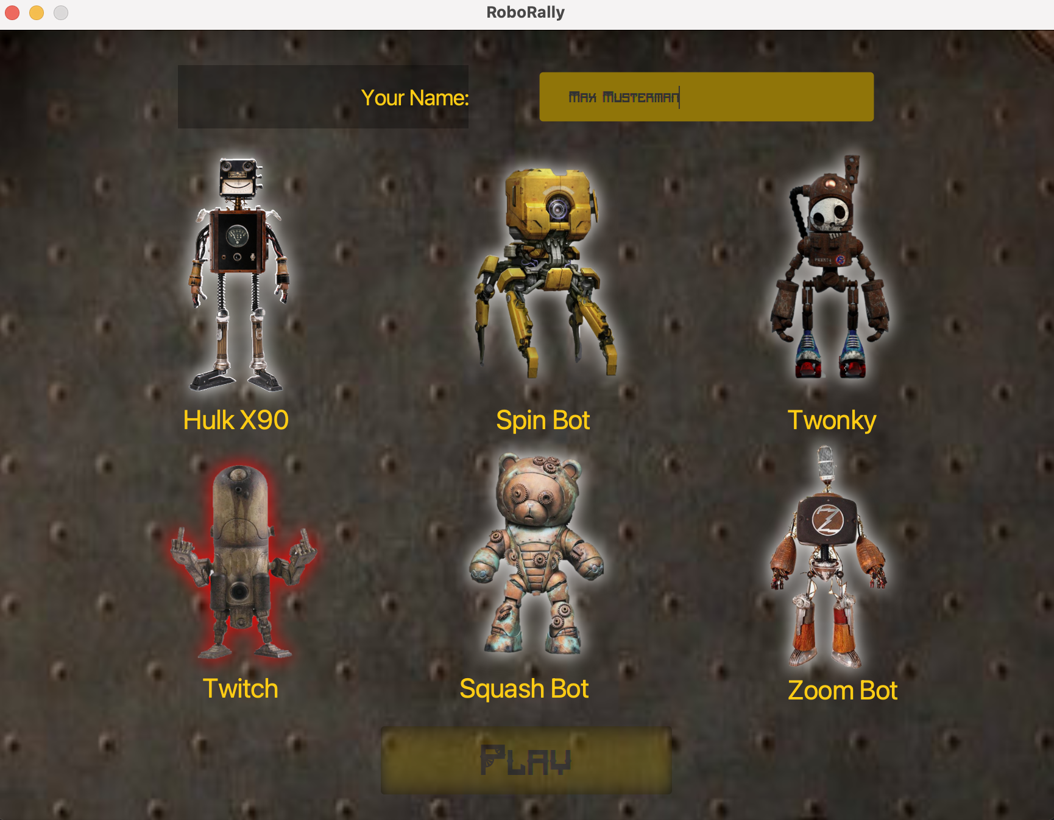
Choose Robot
1 Textfield and 1 Button
6 Robots to choose from
Give your name in the Box
Choose a Robot
Press the play button to open the Game window

Slide 10
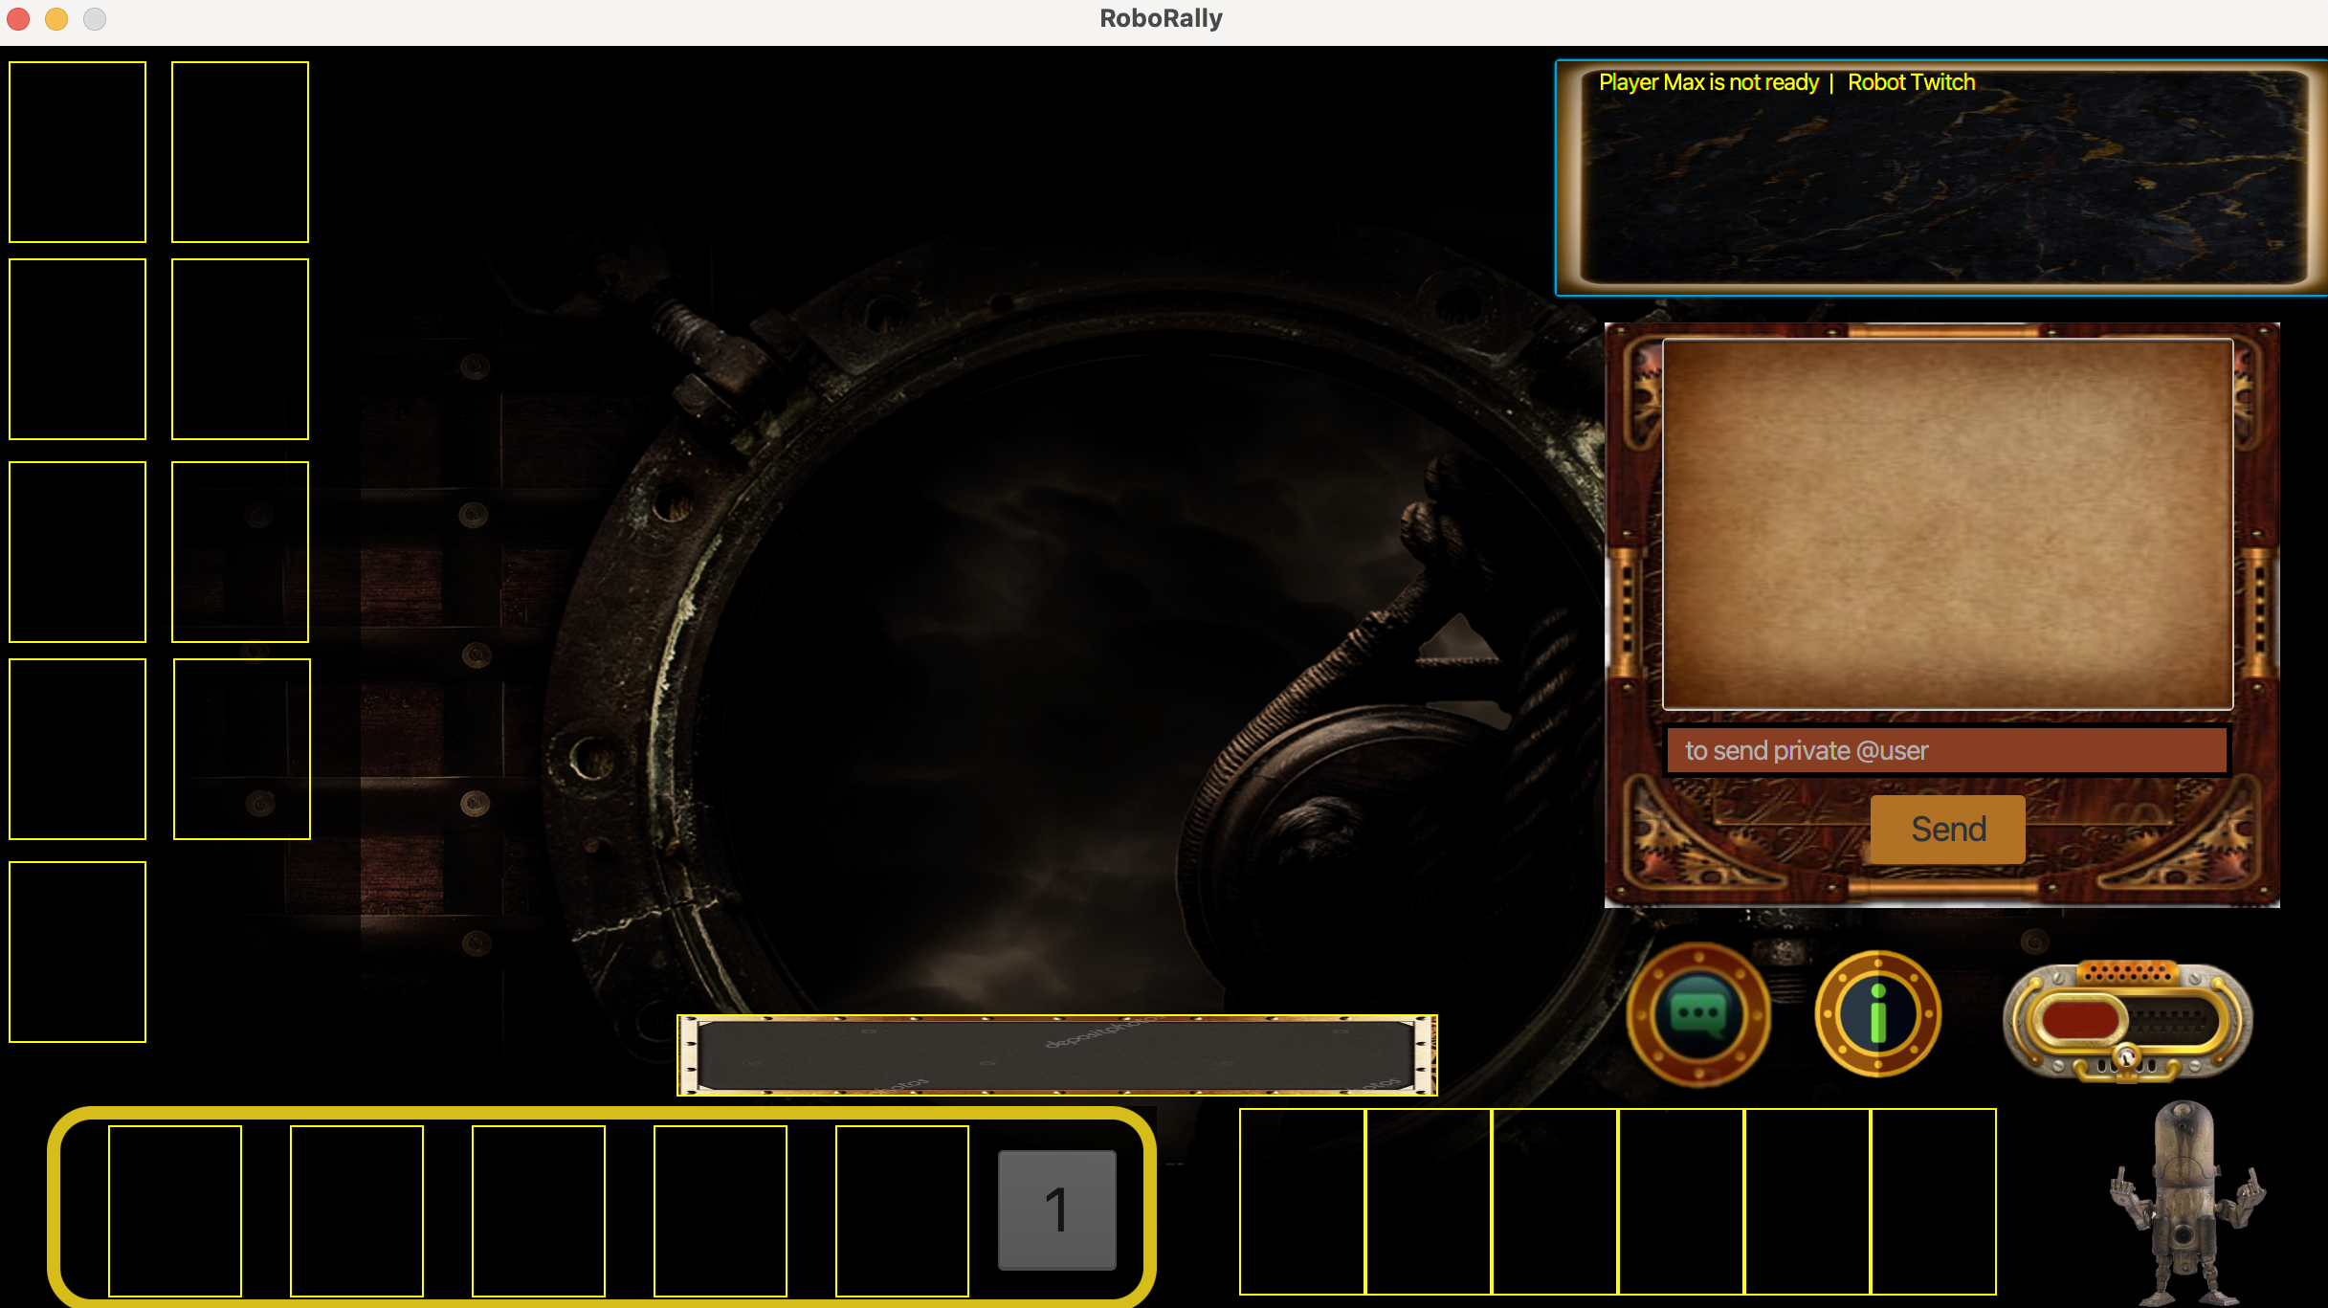
Chat in the Game
4 Buttons
Chat button opens or closes the chat window
Info button for the game guide
Ready flip button to claim your are ready for the rumble
Send button to send what you have to say
One can even send a private chat with an @name in front of the message

Slide 11
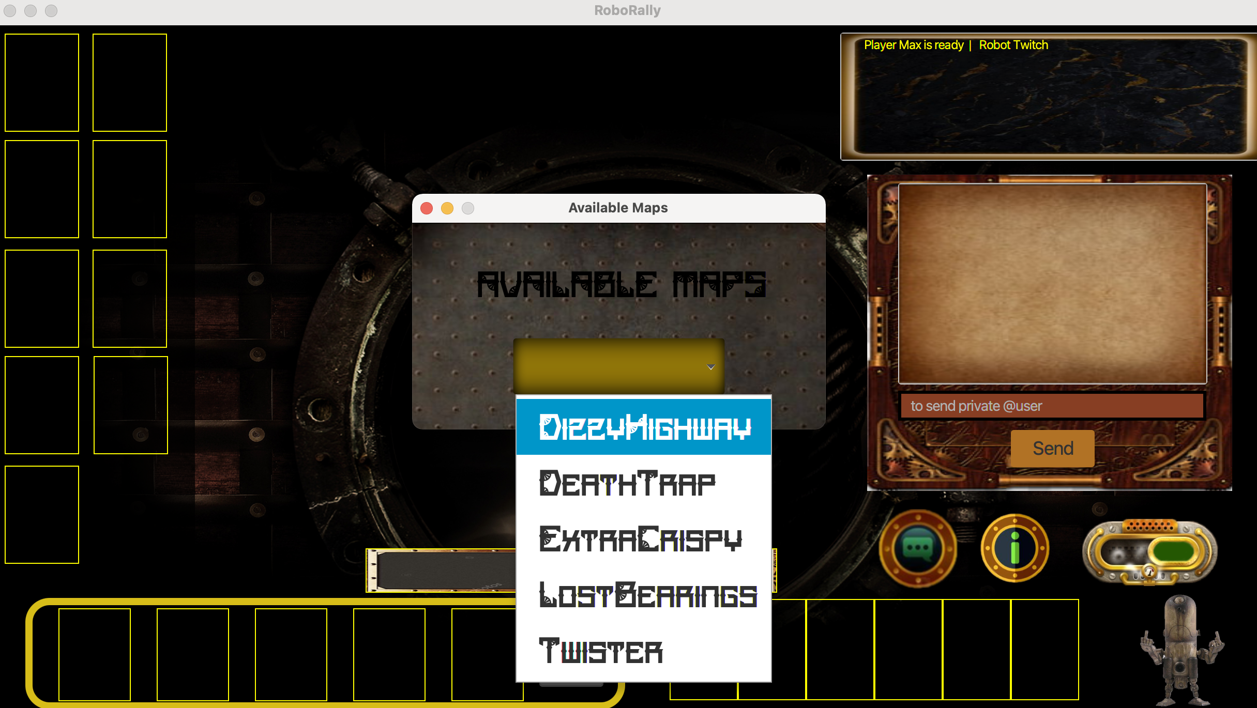
Available Maps
After you flip the ready button it turns to green and you get an Available Maps window
You can choose a deadly Map from the choices if you dare

Slide 12
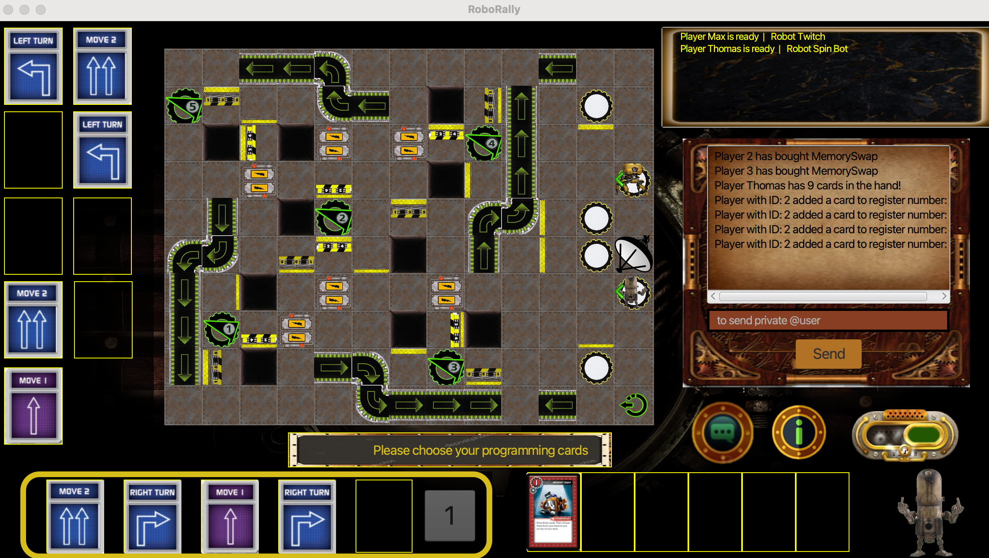
Playing the Game
How to play ? It is easy, just select a card from your hand on the left and drag and drop it into one of your registers on the bottom
Play button shows you the register to play
There is special place for you upgrade cards

Slide 13
Playing the Game, Step by Step
Choose a Starting point bu clicking on it. Closest to the antenna starts first
Reach the Check Points, in order !
You might pick up energy cubes along the way
Conveyor Belts to speed things up

Slide 14
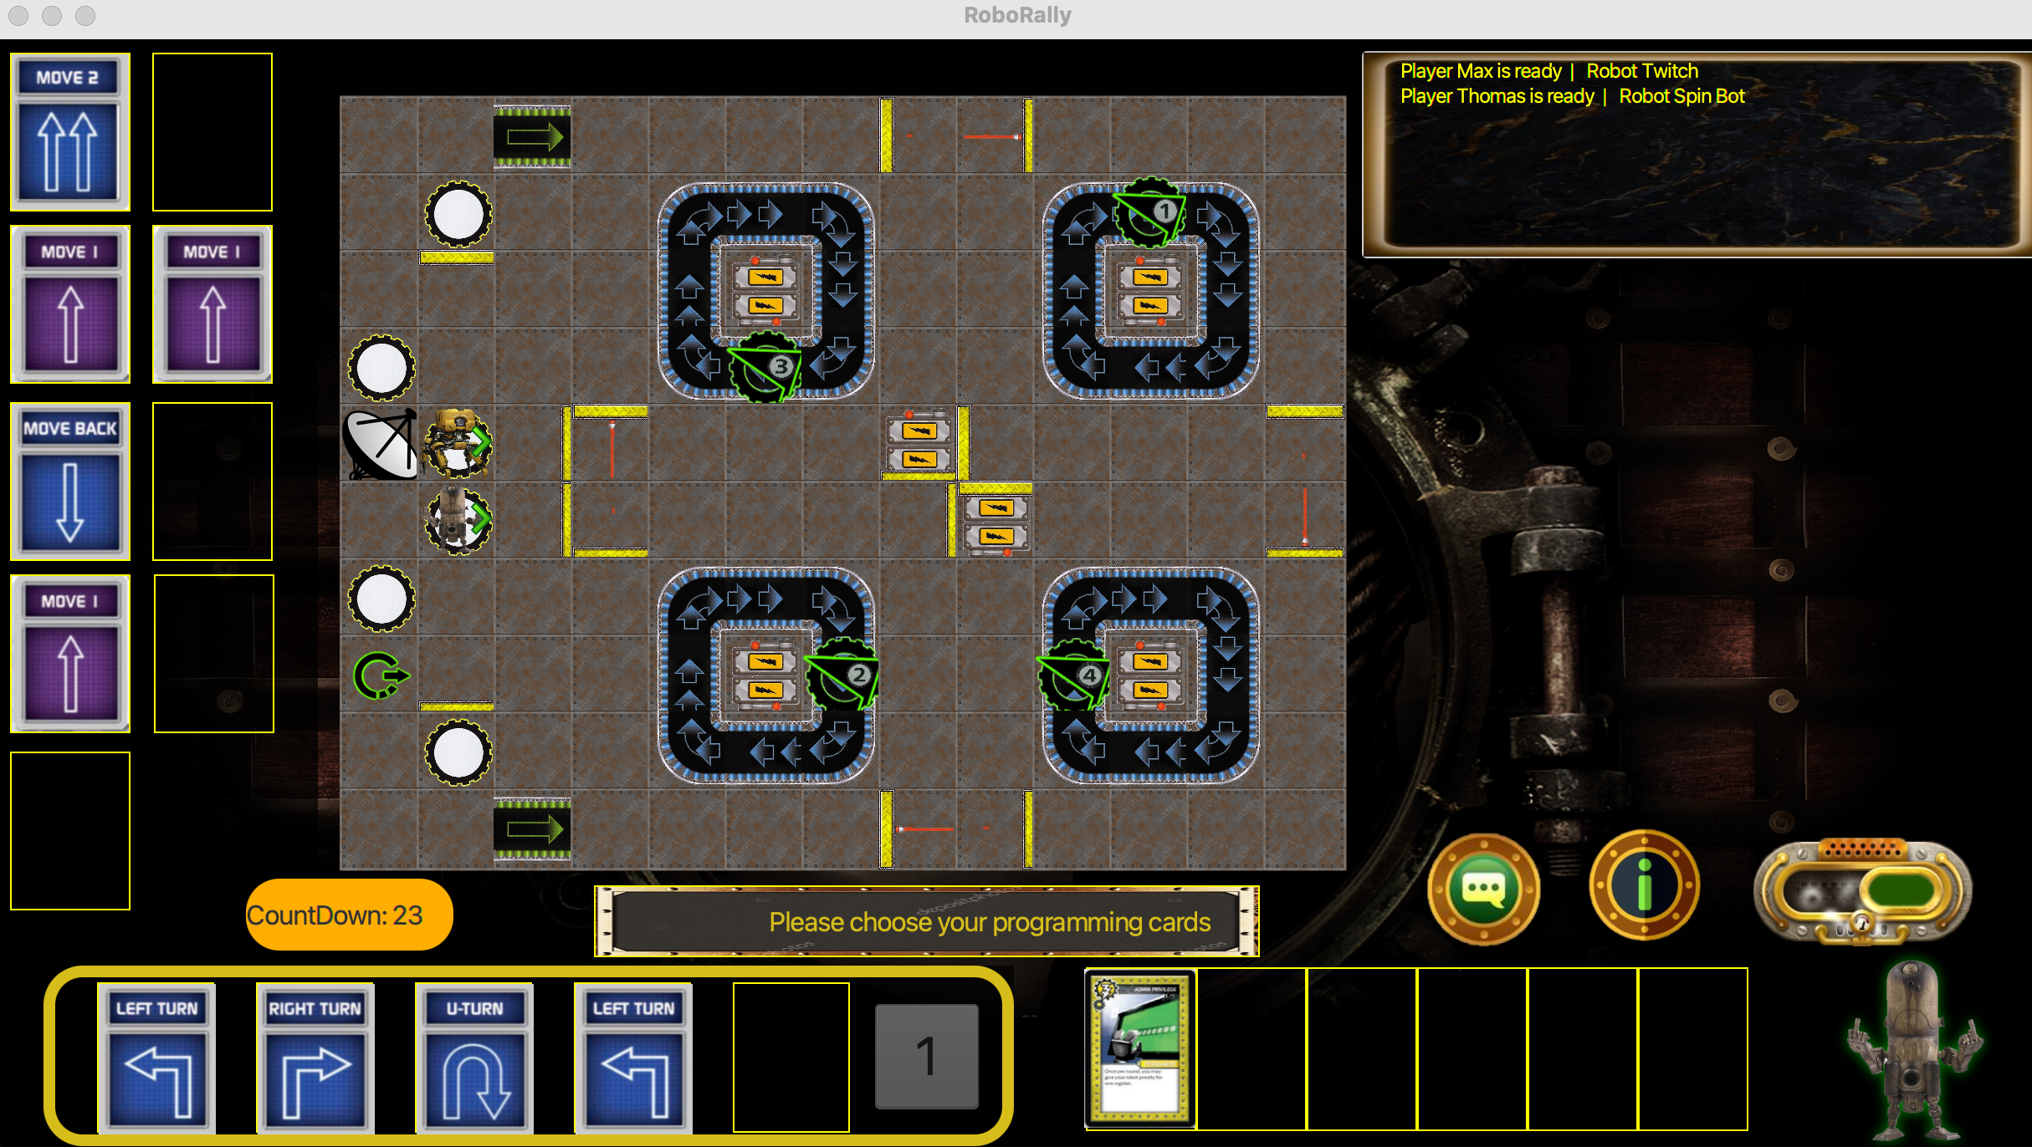
Counter
If your enemy is done picking the cards, the count-down starts.

Slide 15
Game Elements
Find your way to the check points on the rusty tiles of steampunk Robo-Rally.
Avoid lasers!
Push panels are the bullies of the map. But they only push you if they do not like your register number.
Do not fall in to the Pits!
Do not fall off the board!
If you refuse to previous bullet points, then you end up on the green restart point.
Gears are harmless, although one might get dizzy standing on it.

Slide 16
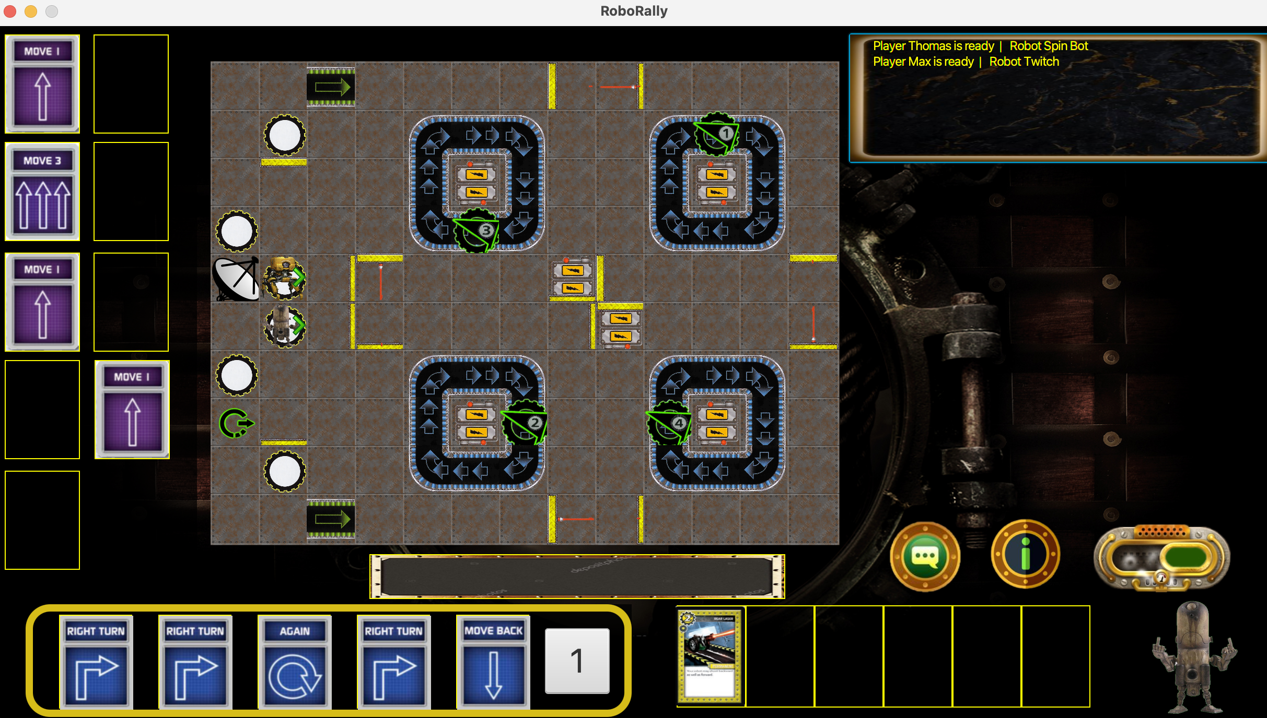
Bullies in the Game ?
Of course. You might have to fight off couple of “punk” robots.

Slide 17
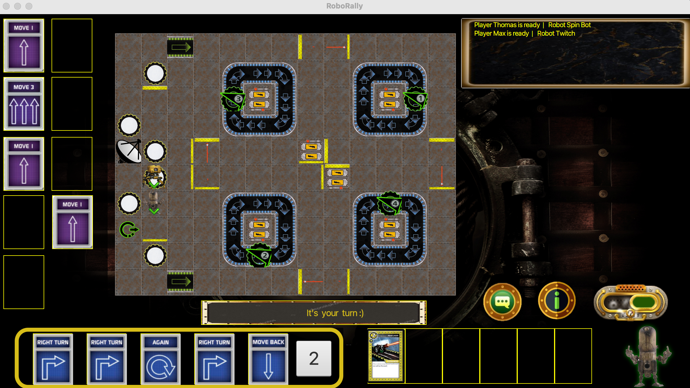
Look at him pushing the other robot. Such a bully.

Slide 18
Conclusion

Slide 19
“If you are persistent enough, you might even see the last window.”
–Blinde-Bonbons

Slide 20
